Slide 1
WELCOME!!!

Slide 2
During this lesson you will learn to use smalls units of English that will be useful to build up sentences, paragraphs, essays etc. Besides you will learn basic vocabulary of days of the week, months of the year etc. So the topis are:
Days of the week
Months of the year
Demonstratives
There is-there are
LET´S START…

Slide 3
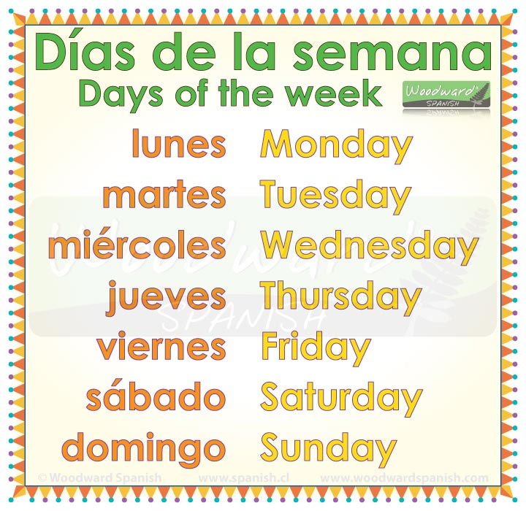

DAYS OF THE WEEK
WEEKDAYS
WEEKEND

Slide 4
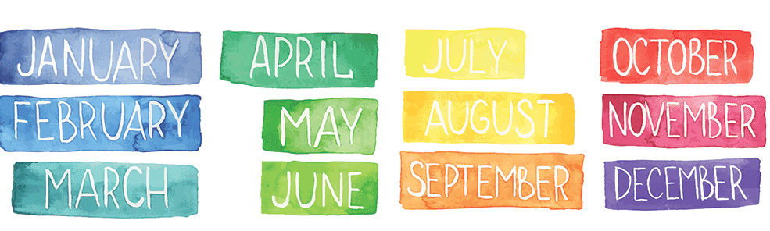
MONTHS OF THE YEAR

Slide 5
KEY VOCABULARY
TODAY = HOY
TOMORROW = MAÑANA
YESTERDAY= AYER
BEFORE YESTERDAY= ANTES DE AYER
AFTER TOMORROW = PASADO MAÑANA
BEFORE= ANTES
AFTER= DESPUES
ON = PARA LOS DIAS DE LA SEMANA Y FECHAS COMPLETAS. Example: On Monday, On February 27th
IN= MESES DEL AÑO Y AÑOS . Example : In March,
In 1997

Slide 6
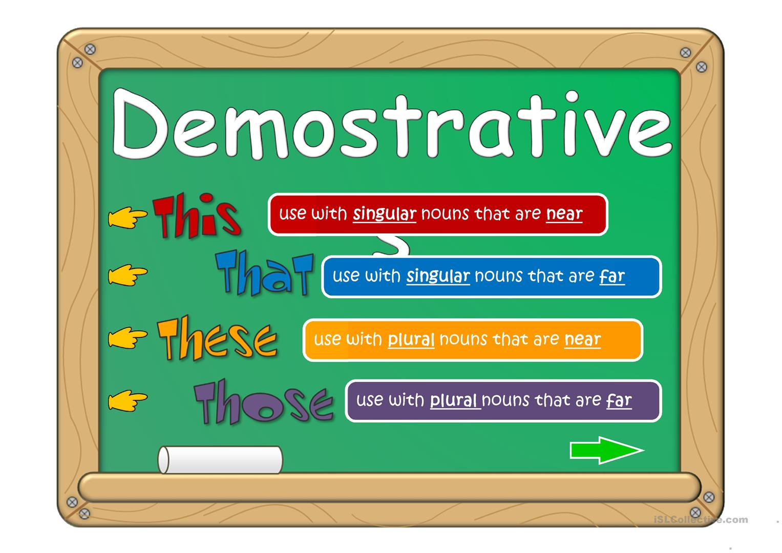
DEMONSTRATIVES
Demonstratives in English are 4 words that means: esto(a), eso(a), estos (as) and esos(as)

Slide 7
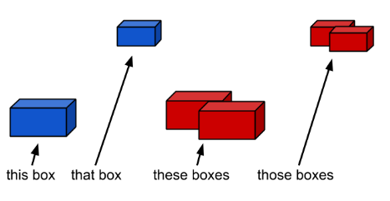
DEMONSTRATIVES
We use demonstratives followed by NOUNS, they can be singular or plural. Look at the following example with the noun «BOX» (CAJA)

Slide 8
THERE IS – THERE ARE (HAY)
In English we use there is and there are to say that something exists or doesn´t exist. Example
There is a sun in the sky = Hay un sol en el cielo
There are 20 students in the classroom = Hay 20 estudiantes en el salon de clases
You can use these two words in positive, negative, and question form, but you need to follow some rules, Look at the explanation

Slide 9
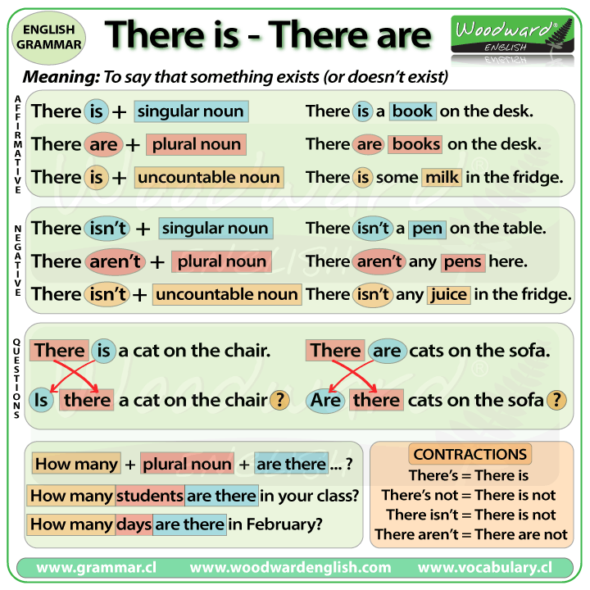
DON´T USE «ANY» WITH SINGULAR NOUNS

Slide 10
Is there a cat on the sofa?
Yes, there is a cat on the sofa
No , there isn´t a cat on the sofa
Are there cats on the sofa?
Yes, there are cats on the sofa
No , there are not cats on the sofa
How many students are there in the class?
There is 1 student in the class
There are 20 students in the class
BED BEDS

